Slide 1
Applied Asymmetric Cryptography Anshul Gupta
Thales Learning Partners

Slide 2

Anshul Gupta Distinguished Technical Lead DES, MCS
Your Profile
PDA/PLA – Cloud OTA
8+ years of experience
Security Enthusiast
Security Champion – Secure Code Warrior
President – Thales Toastmasters Club
Avid Reader

Slide 3
Agenda of the program
Day 2
Discrete Logarithmic Problem
DHKE
ECC
Day 1
Introduction to Cryptography
Symmetric Cryptography
Asymmetric Cryptography
Euclidean Algorithm
Extended Euclidean Algorithm
RSA
Primitive Roots

Slide 4
Prerequisites
Laptop
OpenSSL installed
GPG installed
Zeal for learning
Pen and Notebook

Slide 5
What is Cryptography ?
Cryptography is the art and science of secure communication.
It involves the study of techniques for constructing and analyzing protocols that enable the confidentiality, integrity, and authenticity of information, even in the presence of malicious adversaries.

Slide 6
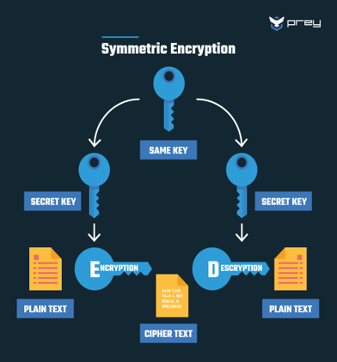
Symmetric Cryptography
Symmetric cryptography, also known as secret-key cryptography, is a fundamental technique in the field of cybersecurity.
single key used – also known as shared secret, shared between sender and receiver.
Highly Efficient.
Also known as Private Key Cryptography.
Algorithms
DES – Data Encryption Standard
3DES – Triple DES
AES – Advance Encryption Standard

Slide 7
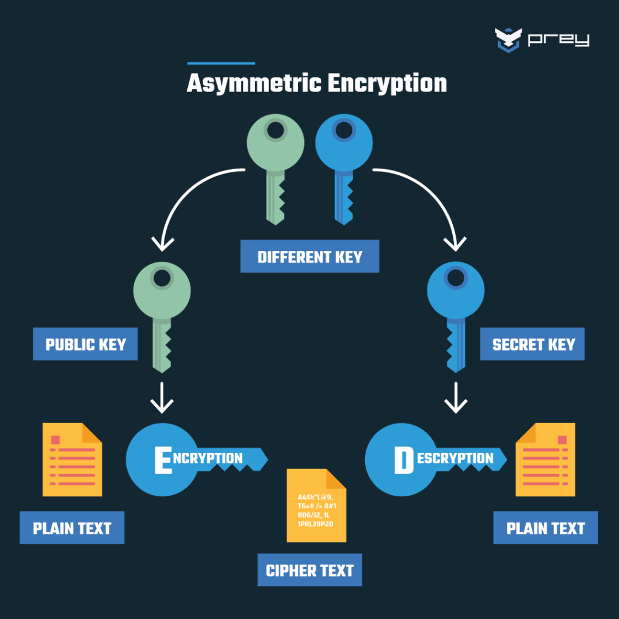
Asymmetric Cryptography
Asymmetric cryptography, also known as public key cryptography, is a fundamental technique in the field of cybersecurity.
pair of keys used – public and private
public key is widely shared – used by anyone to encrypt message meant for key’s owner
private key is private – only owner has it – used to decrypt messages that have been encrypted with corresponding public key
Advantages like secure key exchange, digital signature for authentication and non-repudiation
Algorithms
RSA
ECC
DHKE

Slide 8
Euclidean Algorithm
The Euclidean algorithm is a method to find the greatest common divisor (GCD) of two integers.
Algorithm
Given two integers a and b (where a ≥ b), the Euclidean algorithm can be described as follows:
Step 1: Divide a by b to get the quotient q and remainder r. a = b*q + r
Step 2: Replace a with b and b with r, then repeat the process.
Step 3: Continue this process until the remainder r becomes 0. The non-zero remainder from the previous step is the GCD of a and b.
Example:
Finding GCD of 60 and 24, a = 60, b = 24
a = b*q + r
60 = 24*2 + 12
24 = 12*2 + 0
The GCD is the last non-zero remainder, which is 12.

Slide 9
Extended Euclidean Algorithm
The Extended Euclidean Algorithm is an extension of the Euclidean Algorithm.
In addition to finding the greatest common divisor (GCD) of two integers, it also finds coefficients (often called Bézout coefficients) x and y such that: GCD(a,b) = ax + by
This is particularly useful in applications like cryptography, where you need to find the modular inverse of a number.
Example:
Let’s take up our previous example. GCD(60,24) = 12
Express 12 as a linear combination of 60 and 24
12 = 60 – 24*2 = 60*1 – 24*2
x = 1 and y = -2

Slide 10

Rivest Shamir Adleman (RSA)
Developed in 1977 by Ron Rivest, Adi Shamir, and Leonard Adleman.
RSA involves the generation of public and private keys.
Breaking RSA requires factoring the modulus n into its prime factors which is very difficult.
Larger key sizes (e.g., 2048 bits or more) enhance security against brute-force attacks.
Applications – Secure Communication SSL/TLS, Digital Signatures
Hands-on – Section 4 at https://github.com/heartofrevel/CryptographySimplified
Refer https://www.geeksforgeeks.org/rsa-algorithm-cryptography/

Slide 11
RSA Key Generation Process
Step 1: Choose two distinct prime number, p and q.
These prime numbers should be large and randomly chosen. The security of RSA relies on the difficulty of factoring the product of these two large primes.
Step 2: Compute n by multiplying p and q. (n=p*q)
The number n is used as part of both the public and private keys. It's hard to factorize n back into p and q if p and q are large, which is a cornerstone of RSA's security.
Step 3: Compute Euler's Totient Function, ϕ(n). (ϕ(n)=(p−1)×(q−1))
This function counts the number of integers up to n that are relatively prime to n. Since p and q are prime, ϕ(n) is simply the product of (p−1) and (q−1).

Slide 12
RSA Key Generation Process
Step 4: Choose an integer e such that 1<e<ϕ(n) and e is coprime with ϕ(n).
The integer e is usually a small number like 3 or 65537. This value will be the public exponent used in the encryption process. It must be coprime with ϕ(n) to ensure that a multiplicative inverse exists.
Step 5: Compute the private key d, which is the modular multiplicative inverse of e modulo ϕ(n) (d×e≡1 (mod ϕ(n)))
The value d satisfies the above congruence and is used as the private exponent in the decryption process. Finding d is easy if you know ϕ(n), but difficult if you only know n.
Step 6: The public key is (n,e) and the private key is (n,d)

Slide 13
RSA Encryption and Decryption
Given a message m, where m is a plaintext message that has been converted into an integer m such that 0≤m<n
The ciphertext c is computed using the recipient's public key (n,e)
c ≡ m^{e} (mod n)
To decrypt the ciphertext c back to the original message m.
The recipient uses their private key (n,d) to compute.
m ≡ c^{d} (mod n)

Slide 14
RSA Example – Key Pair Generation
Step 1:
Select two prime numbers, let’s say p = 7 and q = 11
Step 2:
Compute modulus, n = p*q = 7*11 = 77
Step 3:
Compute Euler’s Totient Function, ϕ(n)=(p−1)×(q−1)) = 6*10 = 60

Slide 15
RSA Example – Key Pair Generation
Step 4:
Select random e where 1<e<ϕ(n), gcd(e, ϕ(n)) = 1
Let’s say e = 3, we’ll check if e is co-prime with ϕ(n), meaning gcd(e, ϕ(n)) = 1
We will use Euclidean Algorithm to find gcd of 3 and 60, let’s say a = 60, b = 3.
a = b * q + r
60 = 3 * 20 + 0
gcd(3,60)=3, which is not 1, so e=3e = 3e=3 is not coprime with ϕ(n).
Next, try e=7
We will use Euclidean Algorithm to find gcd of 3 and 60, let’s say a = 60, b = 7.
a = b * q + r
60 = 7 * 8 + 4 - Remainder = 4, replace a = 7, b = 4
7 = 4 * 1 + 3 - Remainder = 3, replace a = 4, b = 3
4 = 3 * 1 + 1 - Remainder = 1, replace a = 3, b = 1
3 = 1 * 3 + 0 - Remainder = 0, gcd (7,60) = 1
Our Public Exponent, e = 7

Slide 16
RSA Example – Key Pair Generation
Step 5:
The private exponent d is the modular multiplicative inverse of e modulo ϕ(n)
It satisfied the equation d×e ≡ 1 (mod ϕ(n))
To find d , we solve the equation
d x 7 ≡ 1 (mod 60)
Using the extended Euclidean Algorithm, we have to express 1 as a linear combination of 7 and 60.
1 = 4 – 3 * 1 (Substitute 3 = 7 - 4)
1 = 4 – (7 - 4) = 4 – 7 + 4 = 2 * 4 – 7 (Substitute 4 = 60 – 7 x 8 )
1= 2 * 4 – 7 = 2 (60 – 7 * 8) – 7 = 60 * 2 – 7 * 16 – 7 = 60 * 2 – 17 * 7
x = -17 and y = 2
- 17 * 7 ≡ 1 (mod 60)
d = - 17 ≡ 43 (mod 60)
d = 43, private exponent
Public Key = (e, n) = (7, 77) | Private Key = (d, n) = (43, 77)

Slide 17
RSA Example – Encryption and Decryption
Encryption
Public Key = (7, 77)
Plain text message, m = 17
The encryption formula is c = m^{e} mod n
c = 17⁷ mod 77
17 mod 77 = 17
17² mod 77 = 289 mod 77 = 58
17³ mod 77 = ((17² mod 77)(17 mod 77)) mod 77 = 58*17 mod 77 = 986 mod 77 = 62
17⁴ mod 77 = ((17² mod 77)(17² mod 77)) mod 77 = 58*58 mod 77 = 3364 mod 77 = 53
….
….
17⁷ mod 77 = ((17⁴ mod 77) (17³ mod 77)) mod 77 = 53 * 62 mod 77 = 3286 mod 77 = 52
The ciphered message c = 52

Slide 18
RSA Example – Encryption and Decryption
Decryption
Private Key = (43, 77),
The encryption formula is m = c^{d} mod n
m = 52⁴³ mod 77
52 mod 77 = 52
52² mod 77 = 9
52⁴ mod 77 = ((52² mod 77)(52² mod 77)) mod 77 = 9*9 mod 77 = 81 mod 77 = 4
52⁸ mod 77 = ((52⁴ mod 77)(52⁴ mod 77)) mod 77 = 4*4 mod 77 = 16 mod 77 = 16
52¹⁶ mod 77 = ((52⁸ mod 77)(52⁸ mod 77)) mod 77 = 16*16 mod 77 = 25
52³² mod 77 = ((52¹⁶ mod 77)(52¹⁶ mod 77)) mod 77 = 25*25 mod 77 = 9
52⁴³ mod 77
= ((52³² mod 77)(52⁸ mod 77)(52² mod 77)(52 mod 77)) mod 77
= 9*16*9*52 mod 77
= 67392 mod 77 = 17
The plaintext message m = 17

Slide 19
Why does RSA work ?
From Euler’s Theorem, we know : m^{ϕ(n)} ≡ 1 mod n
In the RSA context
e×d≡1modϕ(n) – This means there exists and integer k such that: e×d=1+k×ϕ(n)
We know, c = m^{e} mod n
and m = c^{d} mod n
= (m^{e} mod n)^{d} mod n
= m^{ed} mod n
= m^{1+k x ϕ(n)} mod n
= m x (m^{ϕ(n)})^{k} mod n
= m x (1)^{k} mod n
≡ m mod n

Slide 20
Primitive Roots
A primitive root of a prime number p is an integer g such that the powers of g generate all the numbers from 1 to p−1 when taken modulo p.
In other words, g is a generator of the multiplicative group of integers modulo p.
For a prime p, an integer g is a primitive root modulo p if for every integer a between 1 and p−1, there exists an integer k such that g^{k} ≡ a mod p
This means that the smallest positive integer k for which g^{k} ≡1 mod p (known as the order of g) is p-1. The number g can generate all numbers in the set {1,2,…,p−1} through its powers.
Formula
Calculate ϕ(n) = p -1 , then calculate all prime factors q of ϕ(n)
For all prime factors, g ^{ϕ(n)/q} != 1 mod p

Slide 21

Primitive Roots – Example
Let’s consider p=7 (a prime number). We want to find a primitive root modulo 7.
Step 1: List the Numbers in the Multiplicative Group
The set of numbers modulo 7 is {1,2,3,4,5,6}. We want to find a number g whose powers generate all these numbers modulo 7.
Step 2: Check Potential Primitive Roots
We’ll test the integers g=2,3,4,5,6 to see which one is a primitive root.
For g=2
2¹ ≡ 2 mod 7 = 2
2² ≡ 4 mod 7 = 4
2³ ≡ 8 mod 7 = 1, the order is 3 and not 6, so, 2 is not a primitive root modulo 7
For g=3
3¹ ≡ 3 mod 7 = 3
3² ≡ 9 mod 7 = 2
3³ ≡ 27 mod 7 = 6
3⁴ ≡ ( 3² mod 7 3² mod 7 ) mod 7 = 2*2 mod 7 = 4
3⁵ ≡ ( 3³ mod 7 3² mod 7 ) mod 7 = 6*2 mod 7 = 5
3⁶ ≡ ( 3³ mod 7 3³ mod 7 ) mod 7 = 6*6 mod 7 = 1
So, 3 is primitive root modulo 7

Slide 22
Discrete Logarithmic Problem
Given a prime number p, a generator g of the multiplicative group modulo p, and an element y in the group, the Discrete Logarithm Problem asks for the integer x such that: y ≡ g^{x} (mod p)
In other words, x is the discrete logarithm of y to the base g modulo p.
Example
Choose a prime number p =17, Choose a generator g = 3
Now, suppose we are given y = 12 and we want to find x such that:
12 ≡ 3^{x} (mod 17)
This means we need to find x such that 3^{x} when divided by 17 gives a remainder of 12.
We can try different values of x until we find the right one:
3¹ = 3 mod 17 = 3
3² = 9 mod 17 = 9
3³ = 27 mod 17 = 10
3⁴ = 81 mod 17 = 13
3⁵ = 243 mod 17 = 5
3⁶ = 729 mod 17 = 16
3⁷ = 2187 mod 17 = 15
3⁸ = 6561 mod 17 = 11
3⁹ = 19683 mod 17 = 12
Here, we find that x=9 satisfies the equation. Thus, the discrete logarithm of 12 to the base 3 modulo 17 is 9.

Slide 23
Discrete Logarithmic Problem
The DLP is considered hard to solve, especially when p is large (e.g., 2048-bit primes), and this difficulty underpins the security of many cryptographic systems.
While calculating y = g^{x} mod p is easy, finding x given y, g, and p is computationally challenging.
The Discrete Logarithm Problem is a cornerstone of modern cryptography, providing a basis for secure communication. Understanding its complexity and the mathematics behind it is essential for comprehending many cryptographic protocols.

Slide 24
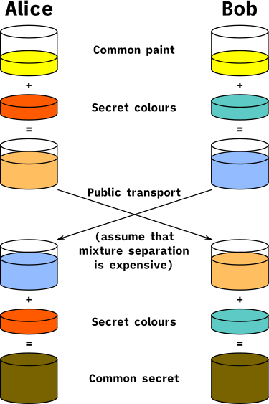
Diffie Helman Key Exchange
cryptographic protocol that allows two parties to establish a shared secret key over an insecure channel.
relies on the principles of public key cryptography. Each party has a private key kept secret and a public key shared openly.
shared secret is generated by each party independently. They combine their own private key with the other party's public key.

Slide 25
Diffie Helman - Algorithm
The math behind it is based on the difficulty of solving discrete logarithm problems in modular arithmetic.
Steps
Public Setup (can be known by both parties)
Choose a large prime number p
Choose a primitive root g modulo p.
Private Keys
Alice selects a private key a, which is a random number.
Bob selects a private key b, which is also a random number.
Both a and b are kept secret.

Slide 26
Diffie Helman - Algorithm
Steps
Public Keys
Alice computes her public key A = gª mod p.
Bob computes his public key B = g^{b} mod p.
Alice sends A to Bob, and Bob sends B to Alice. These public keys can be transmitted over an insecure channel.
Shared Secret
Alice computes the shared secret as s = Bª mod p.
Bob computes the shared secret as s = A^{b} mod p
Mathematically, both calculations yield the same result.
s = Bª mod p = (g^{b} mod p)ª mod p = g^{ba} mod p = g^{ab} mod p = (gª mod p)^{b} mod p = A^{b} mod p

Slide 27
Diffie Helman - Example
Let’s work through an example
Step 1: Public Parameters
Let p = 23 (a prime number)
Let g = 5 (a primitive root modulo 23)
Step 2: Private Keys
Alice chooses a private key a = 6
Bob choose a private key b = 15
Step 3: Public Keys
Alice computes A = gª mod p = 5⁶ mod 23 = 15625 mod 23 = 8
Bob computes B = g^{b} mod p = 5¹⁵ mod 23 = 30517578125 mod 23 = 19
Step 4: Shared Secret
Alice computes the shared secret s = Bª mod p = 19⁶ mod 23 = 470427017 mod 23 = 2
Bob computes the shared secret s = A^{b} mod p = 8¹⁵ mod 23 = 35184372088832 mod 23 = 2
So, both Alice and Bob compute the same shared secret s=2.

Slide 28
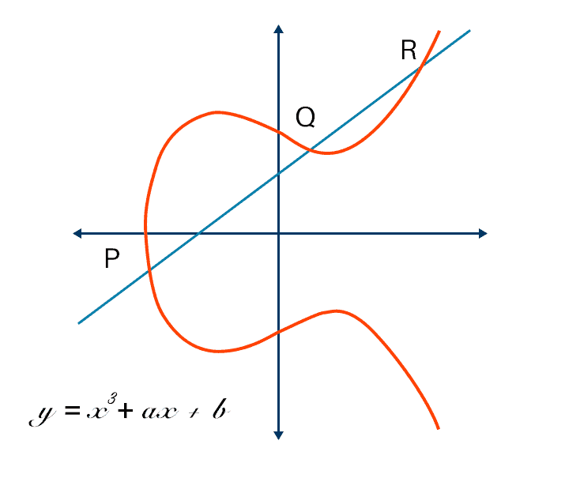
Elliptic Curves
Elliptic curves are a special type of curve defined by a specific kind of cubic equation.
Mathematically, an elliptic curve is usually expressed in the form: y² = x³+ax+b
where a and b are constants such that the curve has no singularities (no self-intersections).
Elliptic curves have a group structure, meaning that you can "add" two points on the curve to get another point on the curve. This is a fundamental property that makes elliptic curves useful in cryptography.
When elliptic curves are defined over finite fields, they are used in cryptographic algorithms, particularly because of their efficiency and strong security properties.

Slide 29
Elliptic Curves
Adding two distinct points P and Q on Elliptic Curves over finite fields.
We have two points P = (x₁, y₁) and Q = (x₂, y₂) on the curve, and these points are distinct P != Q.
The goal is to find a third point R = (x₃, y₃) that is sum of P and Q.
Step by Step Procedure
Calculate the slope λ : λ = y₂-y₁ / x₂-x₁. The slope is the slope of line connecting P and Q.
Find the new x-coordinate x₃ : x₃ = λ² – x₁ – x₂ . This formula comes from the fact that the line intersects the elliptic curve at three points, and we subtract the x-coordinates of P and Q from the square of the slope.
Find the new y-coordinate y₃ : y₃ = λ(x₁ – x₃) – y₁ . This gives the y-coordinate of the resulting point R.
Example
Let’s consider a specific example using a curve defined over a finite field. Suppose we have an elliptic curve y²=x³+2x+2 over F17 and we want to add​ P = (5,1) and Q = (6,3)
λ = 3-1/6-5 = 2/1 = 2 mod 17 = 2
x₃ = 2² -5 -6 = 4 – 11 = -7 mod 17 = 10
y₃ = 2 (5 -10) – 1 = 2 (-5) -1 = -11 mod 17 = 6 . Thus P + Q = (10, 6)

Slide 30
Elliptic Curves
Point Doubling (when P=Q).
When the two points are the same, we’re doubling a point, so the formulas are slightly different.
Step by Step Procedure
Calculate the slope λ : λ = (3x₁² + a )/ 2y₁. This formula accounts for the fact that the tangent to the curve at P (when doubling) is used instead of a secant line.
Find the new x-coordinate x₃ : x₃ = λ² – 2x₁
Find the new y-coordinate y₃ : y₃ = λ(x₁ – x₃) – y₁ .
Example
Let’s consider a specific example using a curve defined over a finite field. Suppose we have an elliptic curve y²=x³+2x+2 over F17 and we want to add​ P = (5,1) and we want to double the point i.e. find 2P.
λ = 3(5)² + 2 / 2(1) = 75 + 2 / 2 = 77 / 2 mod 17 = (77 mod 17 / 2 mod 17) mod 17 = 9/2 mod 17
To find 9/2 mod 17, we need to find multiplicative inverse of 2 modulo 17. It is 9
λ = 9*9 mod 17 = 81 mod 17 = 13
x₃ = 13² – 10 mod 17 = 6 AND y₃ = 13 (5 - 6) – 1 mod 17 = -13 -1 = -14 mod 17 = 3
So 2P = (6, 3)

Slide 31
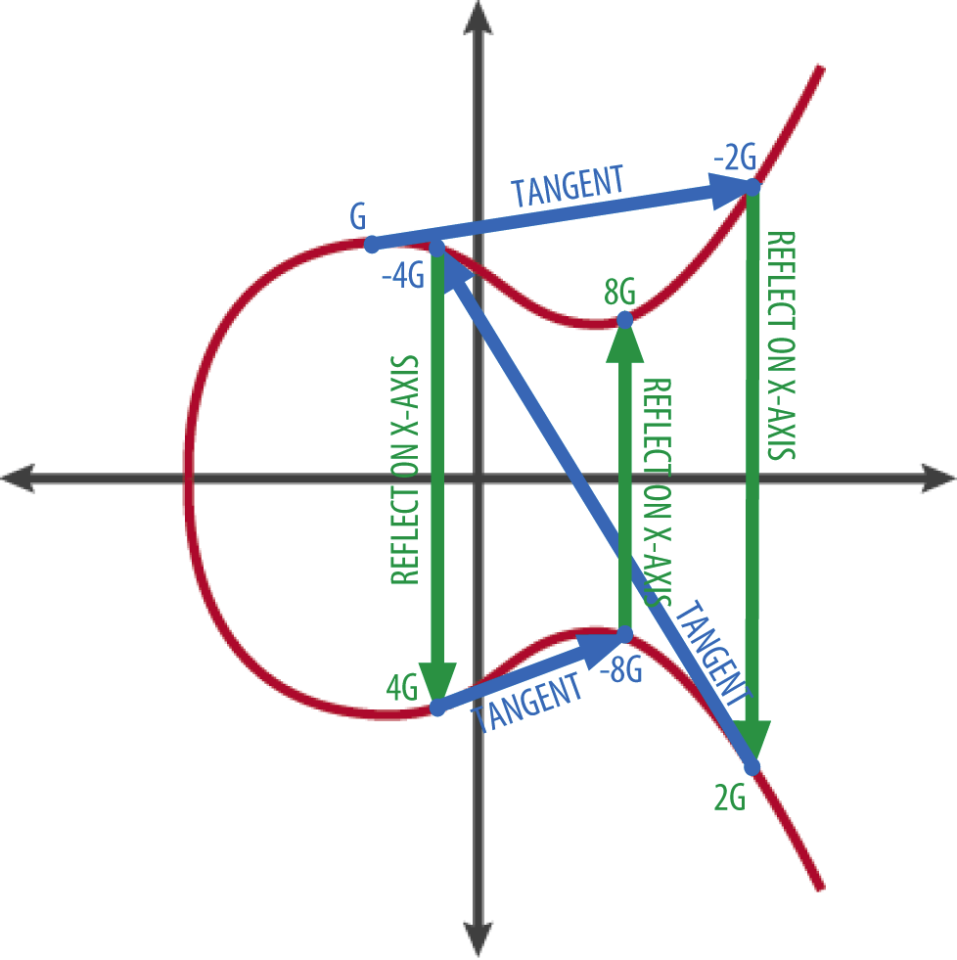
Elliptic Curve Cryptography
public key cryptography
strong security with shorter key lengths
relies on the algebraic structure of elliptic curves over finite fields
relies on the difficulty of the elliptic curve discrete logarithm problem (ECDLP)
widely used in various applications
TLS/SSL for HTTPS
Digital Signatures
Key exchange protocols
Refer https://www.keyfactor.com/blog/elliptic-curve-cryptography-what-is-it-how-does-it-work/

Slide 32
ECC - Algorithm
Step 1: Choose a curve. Let’s say y² = x³+ax+b
Step 2: Choose a prime number. Let’s say p. This will define our Finite Field on curve F_{p}
Step 3: Find point on the curve. Let’s say we take (x,y). We can confirm that this point lies on the curve by putting the point in the equation. This will be our base point G.
Step 4: Choose a private key d.
Step 5: Calculate the public key Q = dG

Slide 33
ECC - Algorithm
Encryption
Suppose Alice wants to send a message to Bob. She uses Bob's public key Q to encrypt the message.
Message: Represent the message as a point M on the curve.
Choose a random integer k. This will be our random ephemeral key, or shared secret
Compute the ciphertext:
C1 = kG
C2 = M+kQ
Ciphertext is (C1, C2)

Slide 34
ECC - Algorithm
Decryption
Bob decrypts the ciphertext (C1, C2) using his private key d.
Shared Secret Calculation: Bob calculates the shared secret by multiplying C1C_1C1​ with his private key
S = dC1 = d(kG) = k (dG) = kQ
Original Message Recovery: Bob recovers the original message point M​ by subtracting the shared secret S from C2:
M = C2 – S = (M + kQ) – kQ = M

Slide 35
ECC - Example
Step 1: Choose a curve. Let’s say y² = x³+2x+2
Step 2: Choose a prime number. Let’s say p = 17. This will define our Finite Field on curve F_{p}
Step 3: Find point on the curve. Let’s say we take (3, 1). We can confirm that this point lies on the curve by putting the point in the equation. This will be our base point G.
Step 4: Choose a private key. Let d = 2
Step 5: Calculate the public key Q = dG = 2(3,1) = (13,7)

Slide 36
ECC – Algorithm
Encryption
Let M = (0,6)
Let k = 3, shared secret
Compute C1 = kG = 3 (3,1) = (0,11)
Compute C2 = M + kQ = (0,6) + 3(13, 7) = (0,11)
Cipher Text = ((0,11), (0,11))
Decryption
We know d = 2
Calculate shared secret S = dC1 = 2(0,11) = (9,16)
Decrypt original message M = C2 - S = (0,11) – (9,16) = (0,11) + (9,-16)= (0,6)

Slide 37
Thank you

